Slide 1



Survey Report
View in Power BI
Last data refresh:
06/11/2024 02:04:12 UTC
Downloaded at:
06/11/2024 03:43:52 UTC

Slide 2
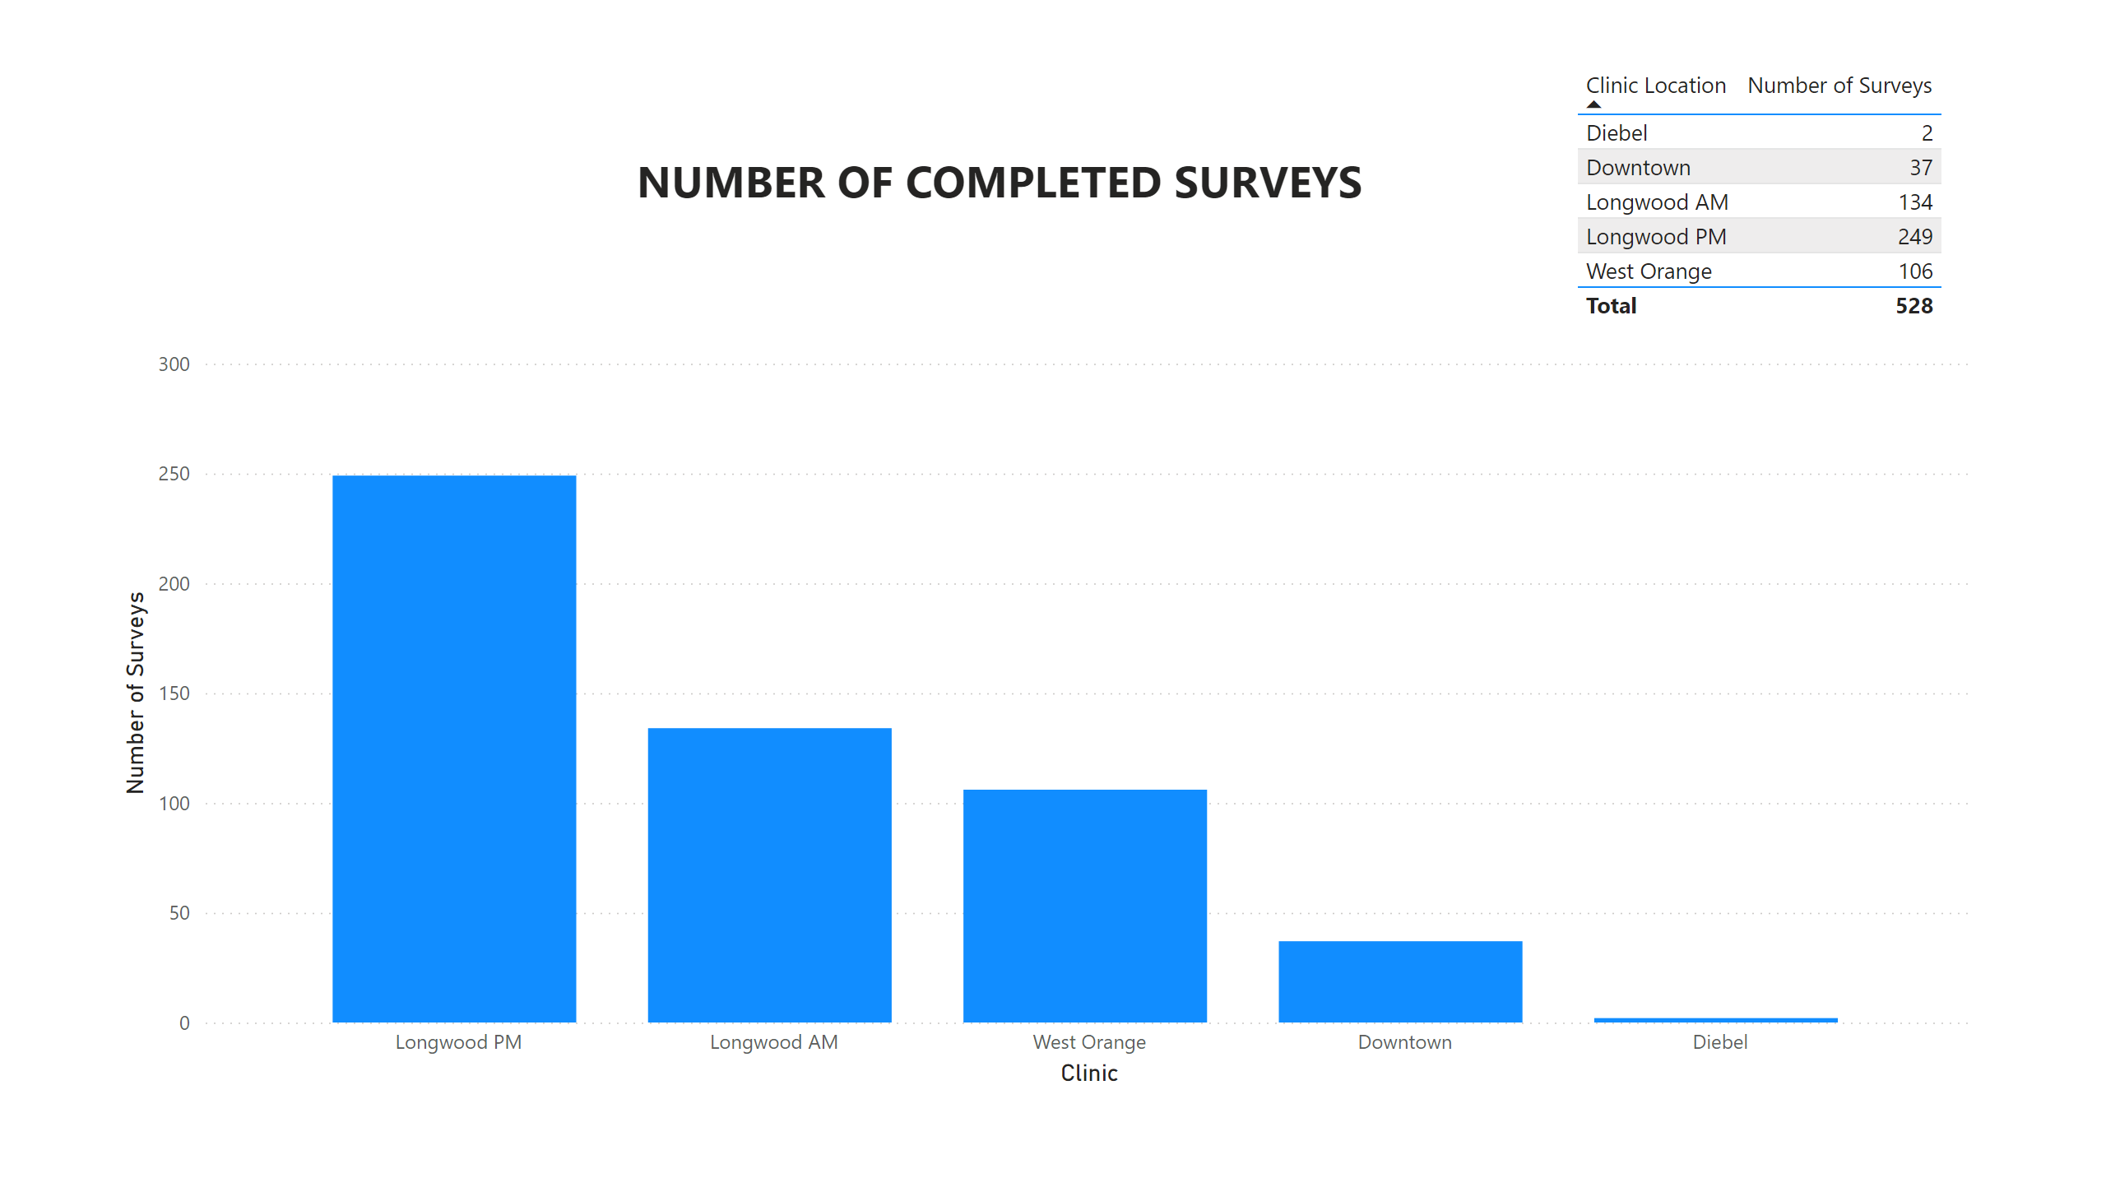
Page 1
Notes:
tableEx
No alt text provided
columnChart
No alt text provided
textbox
No alt text provided

Slide 3
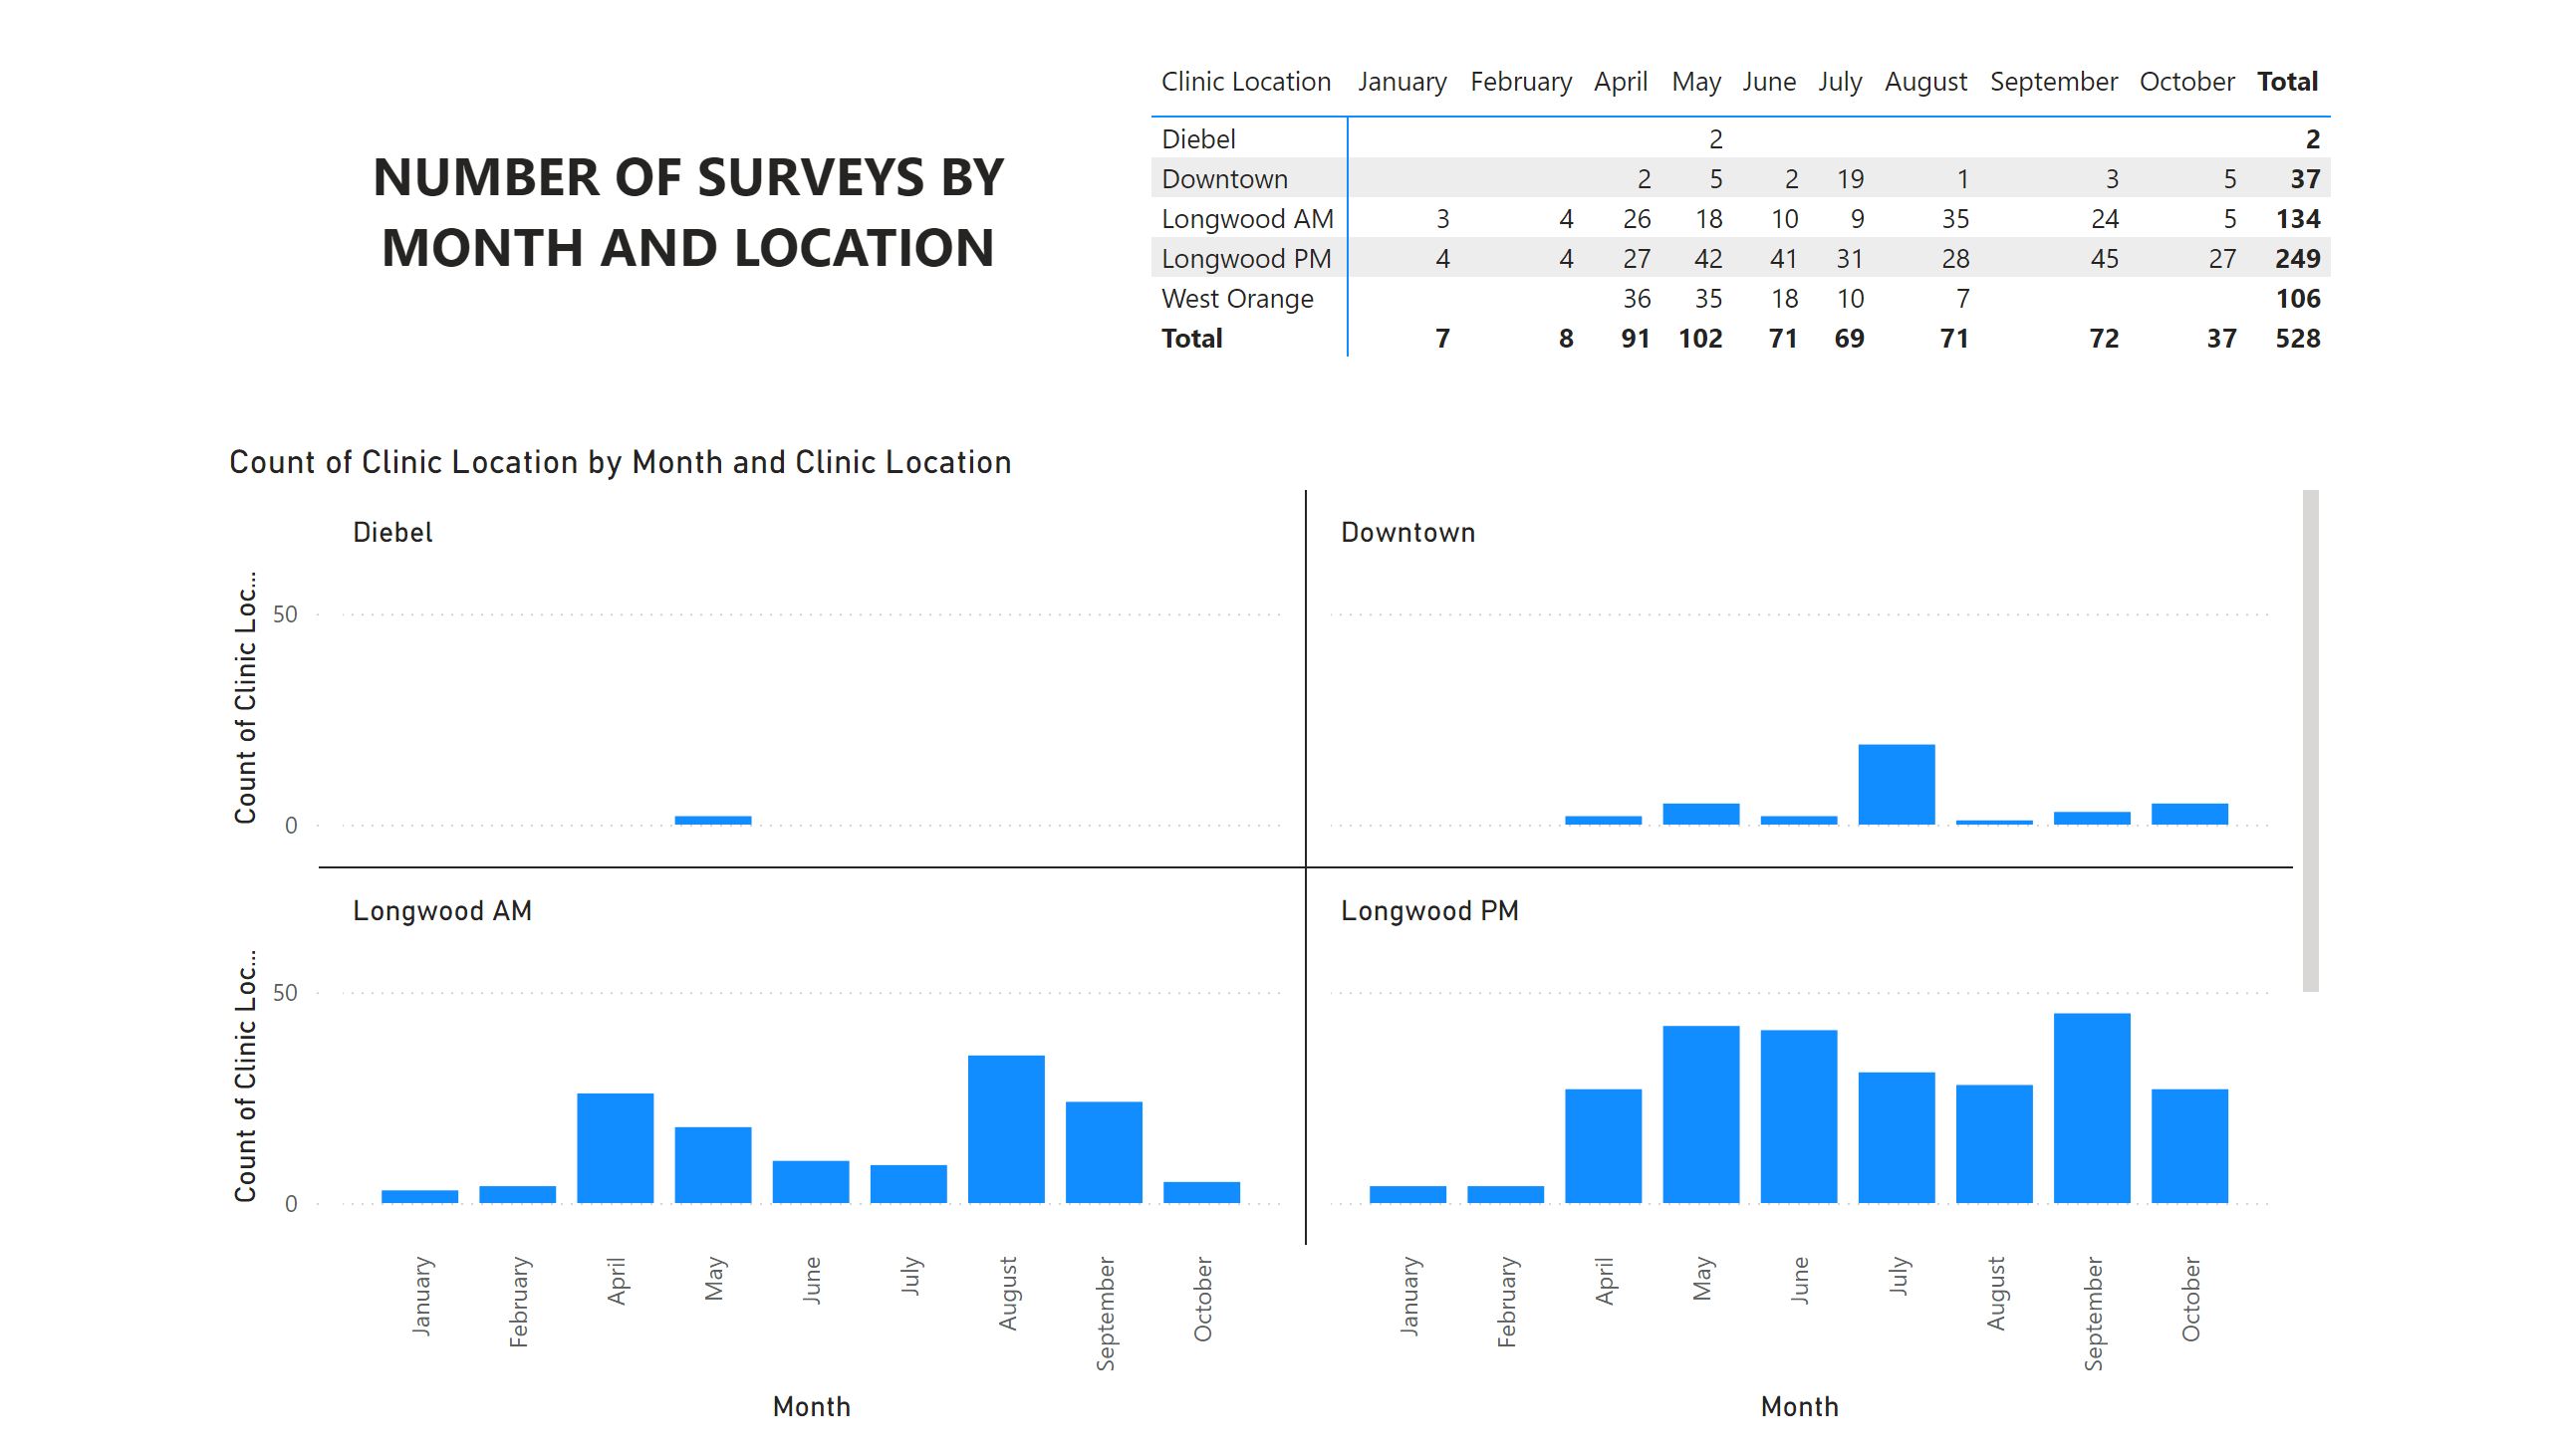
Page 2
Notes:
textbox
No alt text provided
pivotTable
No alt text provided
columnChart
No alt text provided

Slide 4
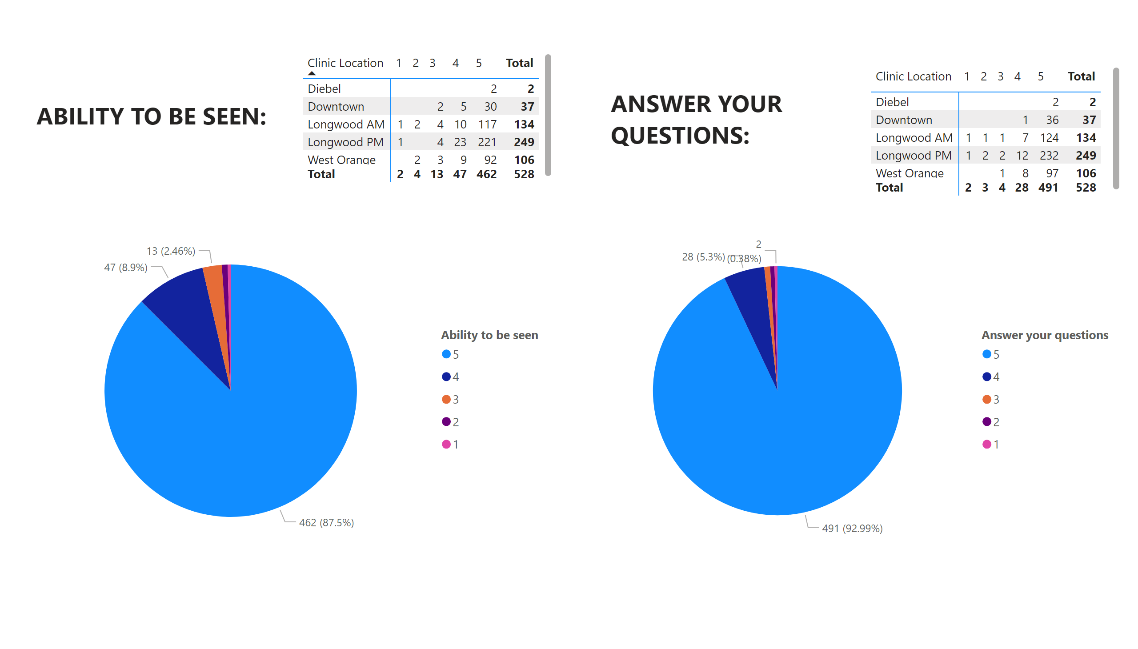
Page 3
Notes:
pieChart
No alt text provided
pivotTable
No alt text provided
textbox
No alt text provided
pieChart
No alt text provided
pivotTable
No alt text provided
textbox
No alt text provided

Slide 5
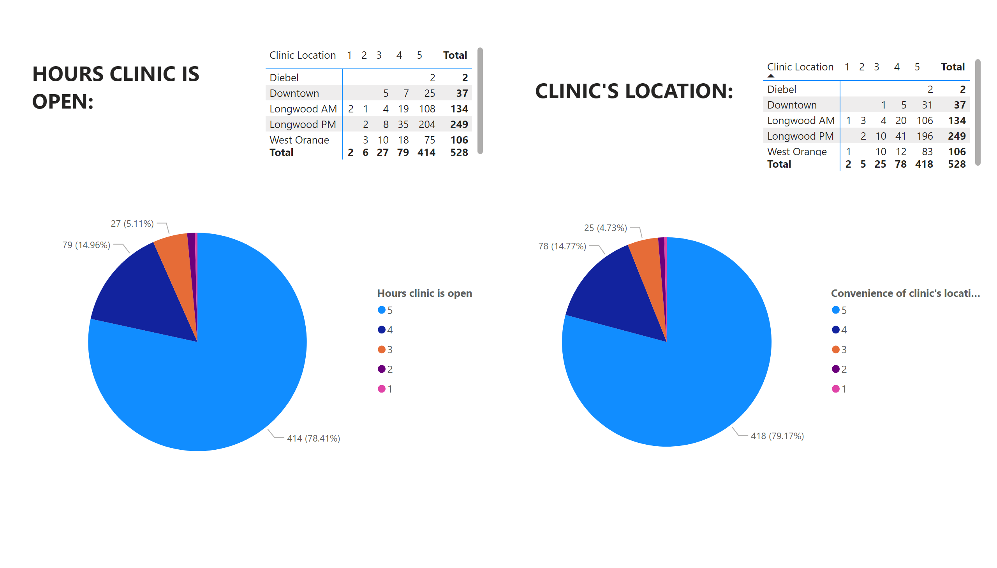
Page 4
Notes:
textbox
No alt text provided
pieChart
No alt text provided
pivotTable
No alt text provided
textbox
No alt text provided
pivotTable
No alt text provided
pieChart
No alt text provided

Slide 6
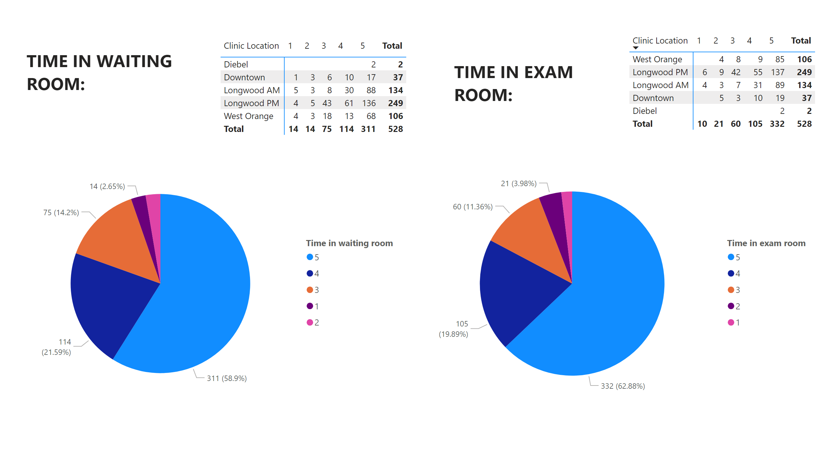
Page 5
Notes:
textbox
No alt text provided
pieChart
No alt text provided
pivotTable
No alt text provided
textbox
No alt text provided
pivotTable
No alt text provided
pieChart
No alt text provided

Slide 7
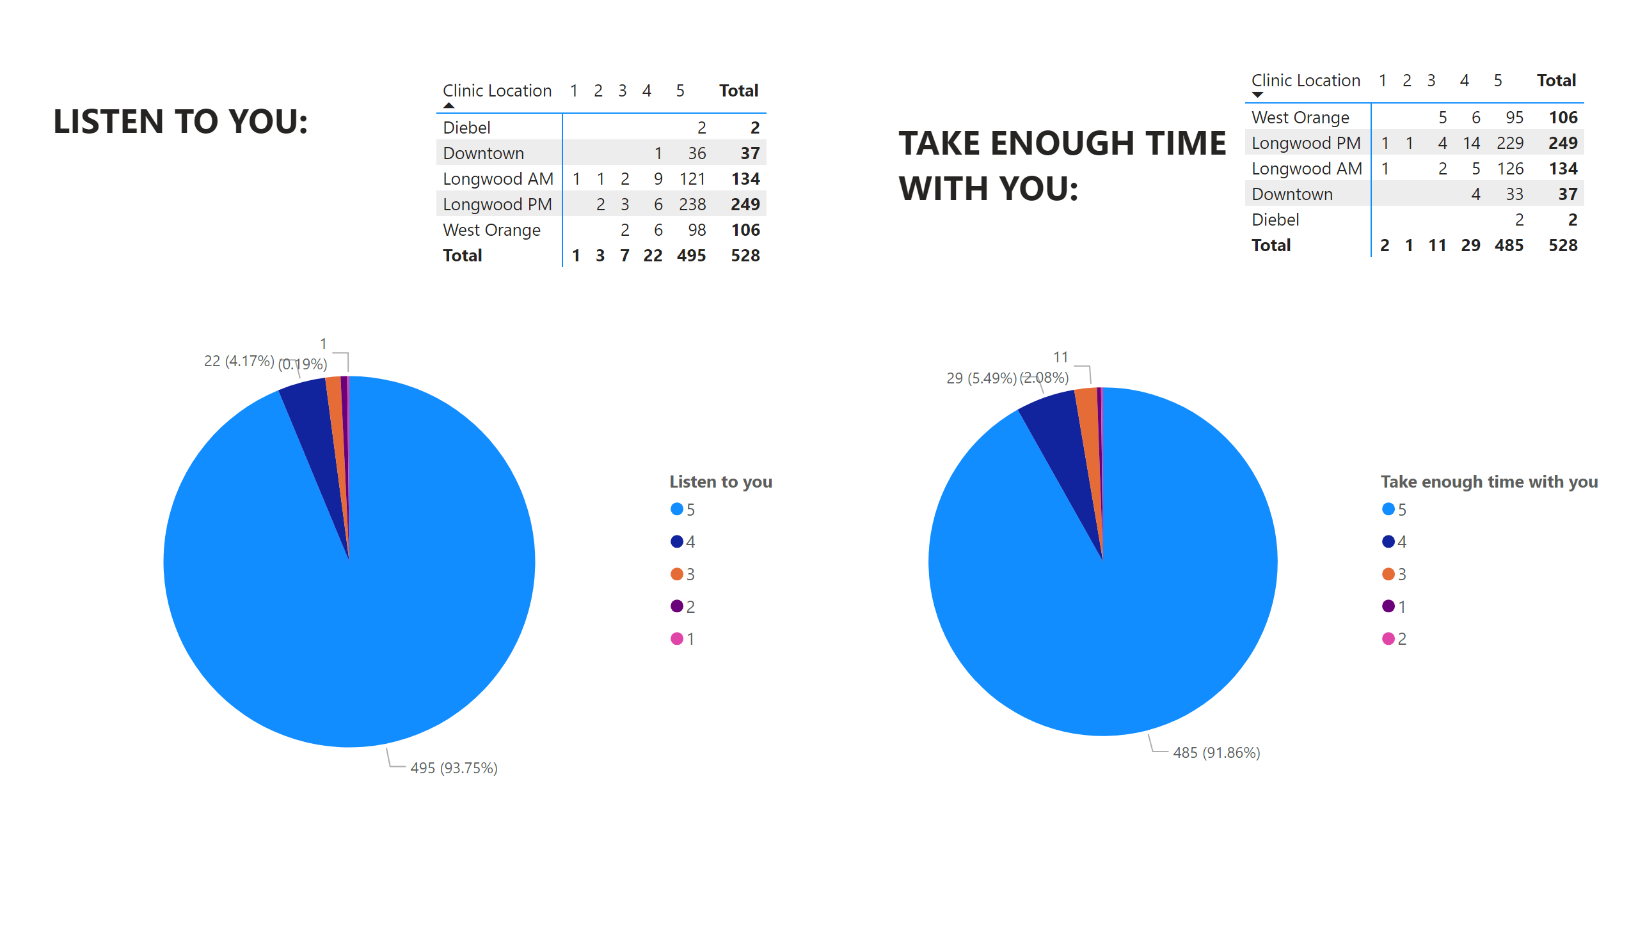
Page 6
Notes:
textbox
No alt text provided
pieChart
No alt text provided
pivotTable
No alt text provided
textbox
No alt text provided
pivotTable
No alt text provided
pieChart
No alt text provided

Slide 8
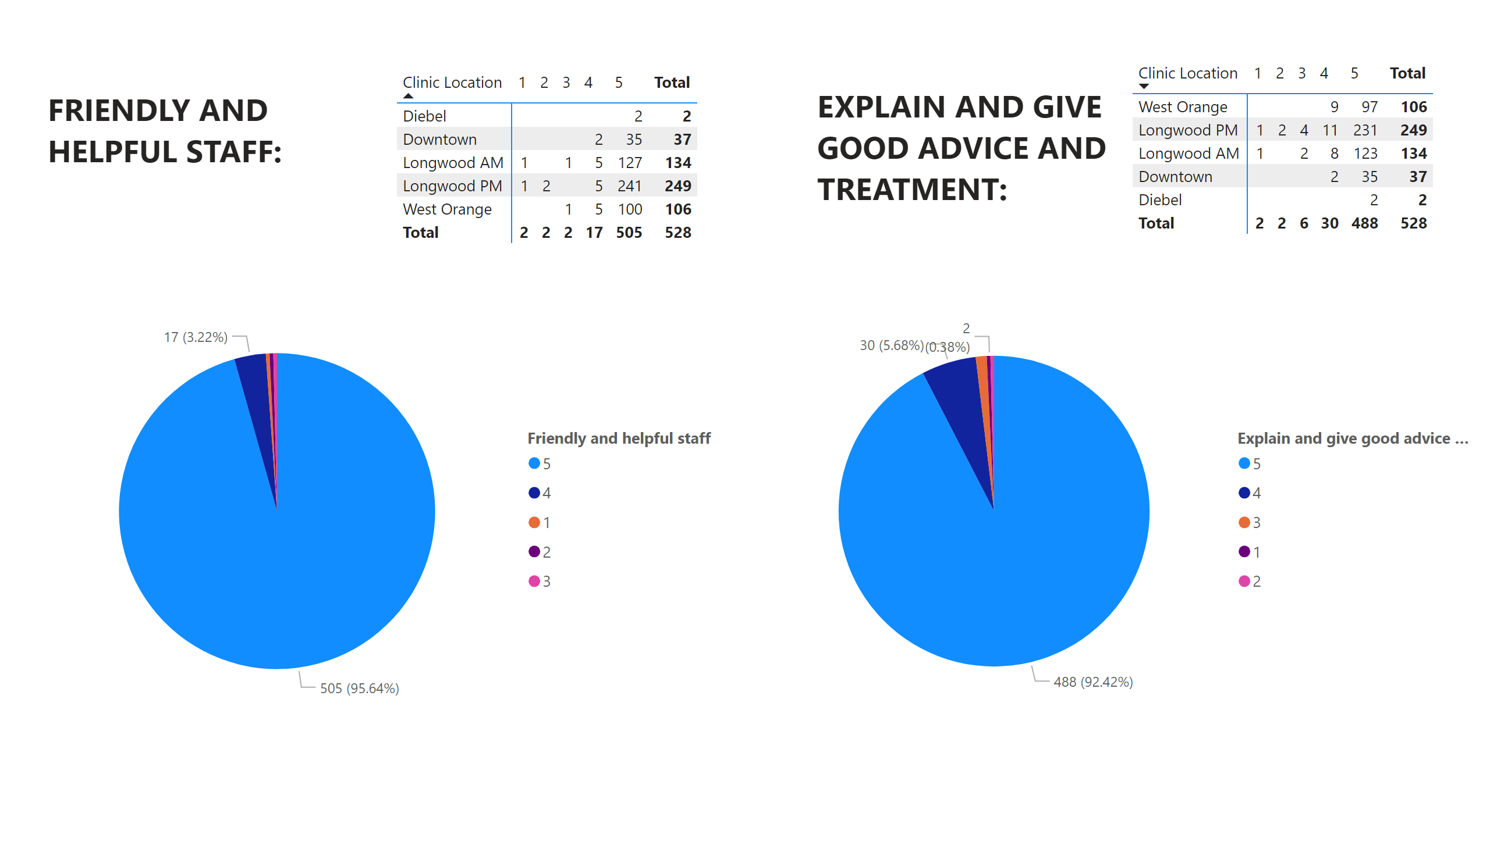
Page 7
Notes:
textbox
No alt text provided
pieChart
No alt text provided
pivotTable
No alt text provided
textbox
No alt text provided
pivotTable
No alt text provided
pieChart
No alt text provided

Slide 9
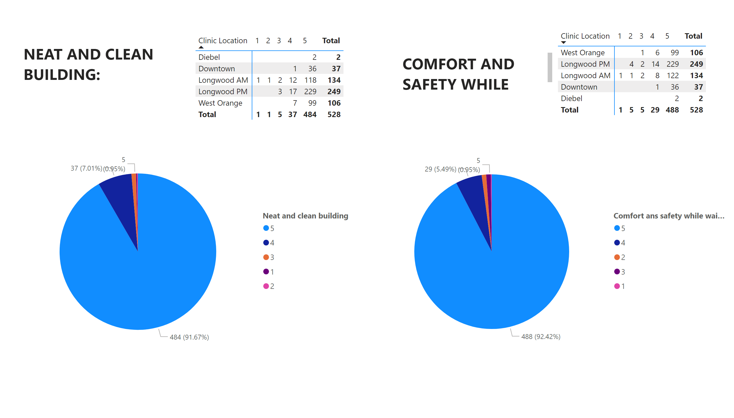
Page 8
Notes:
textbox
No alt text provided
pieChart
No alt text provided
pivotTable
No alt text provided
textbox
No alt text provided
pivotTable
No alt text provided
pieChart
No alt text provided

Slide 10
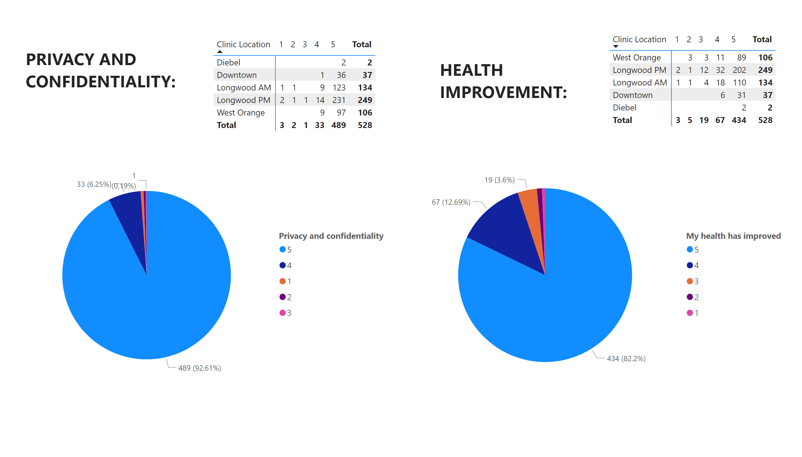
Page 9
Notes:
pivotTable
No alt text provided
textbox
No alt text provided
pieChart
No alt text provided
pivotTable
No alt text provided
textbox
No alt text provided
pieChart
No alt text provided

Slide 11
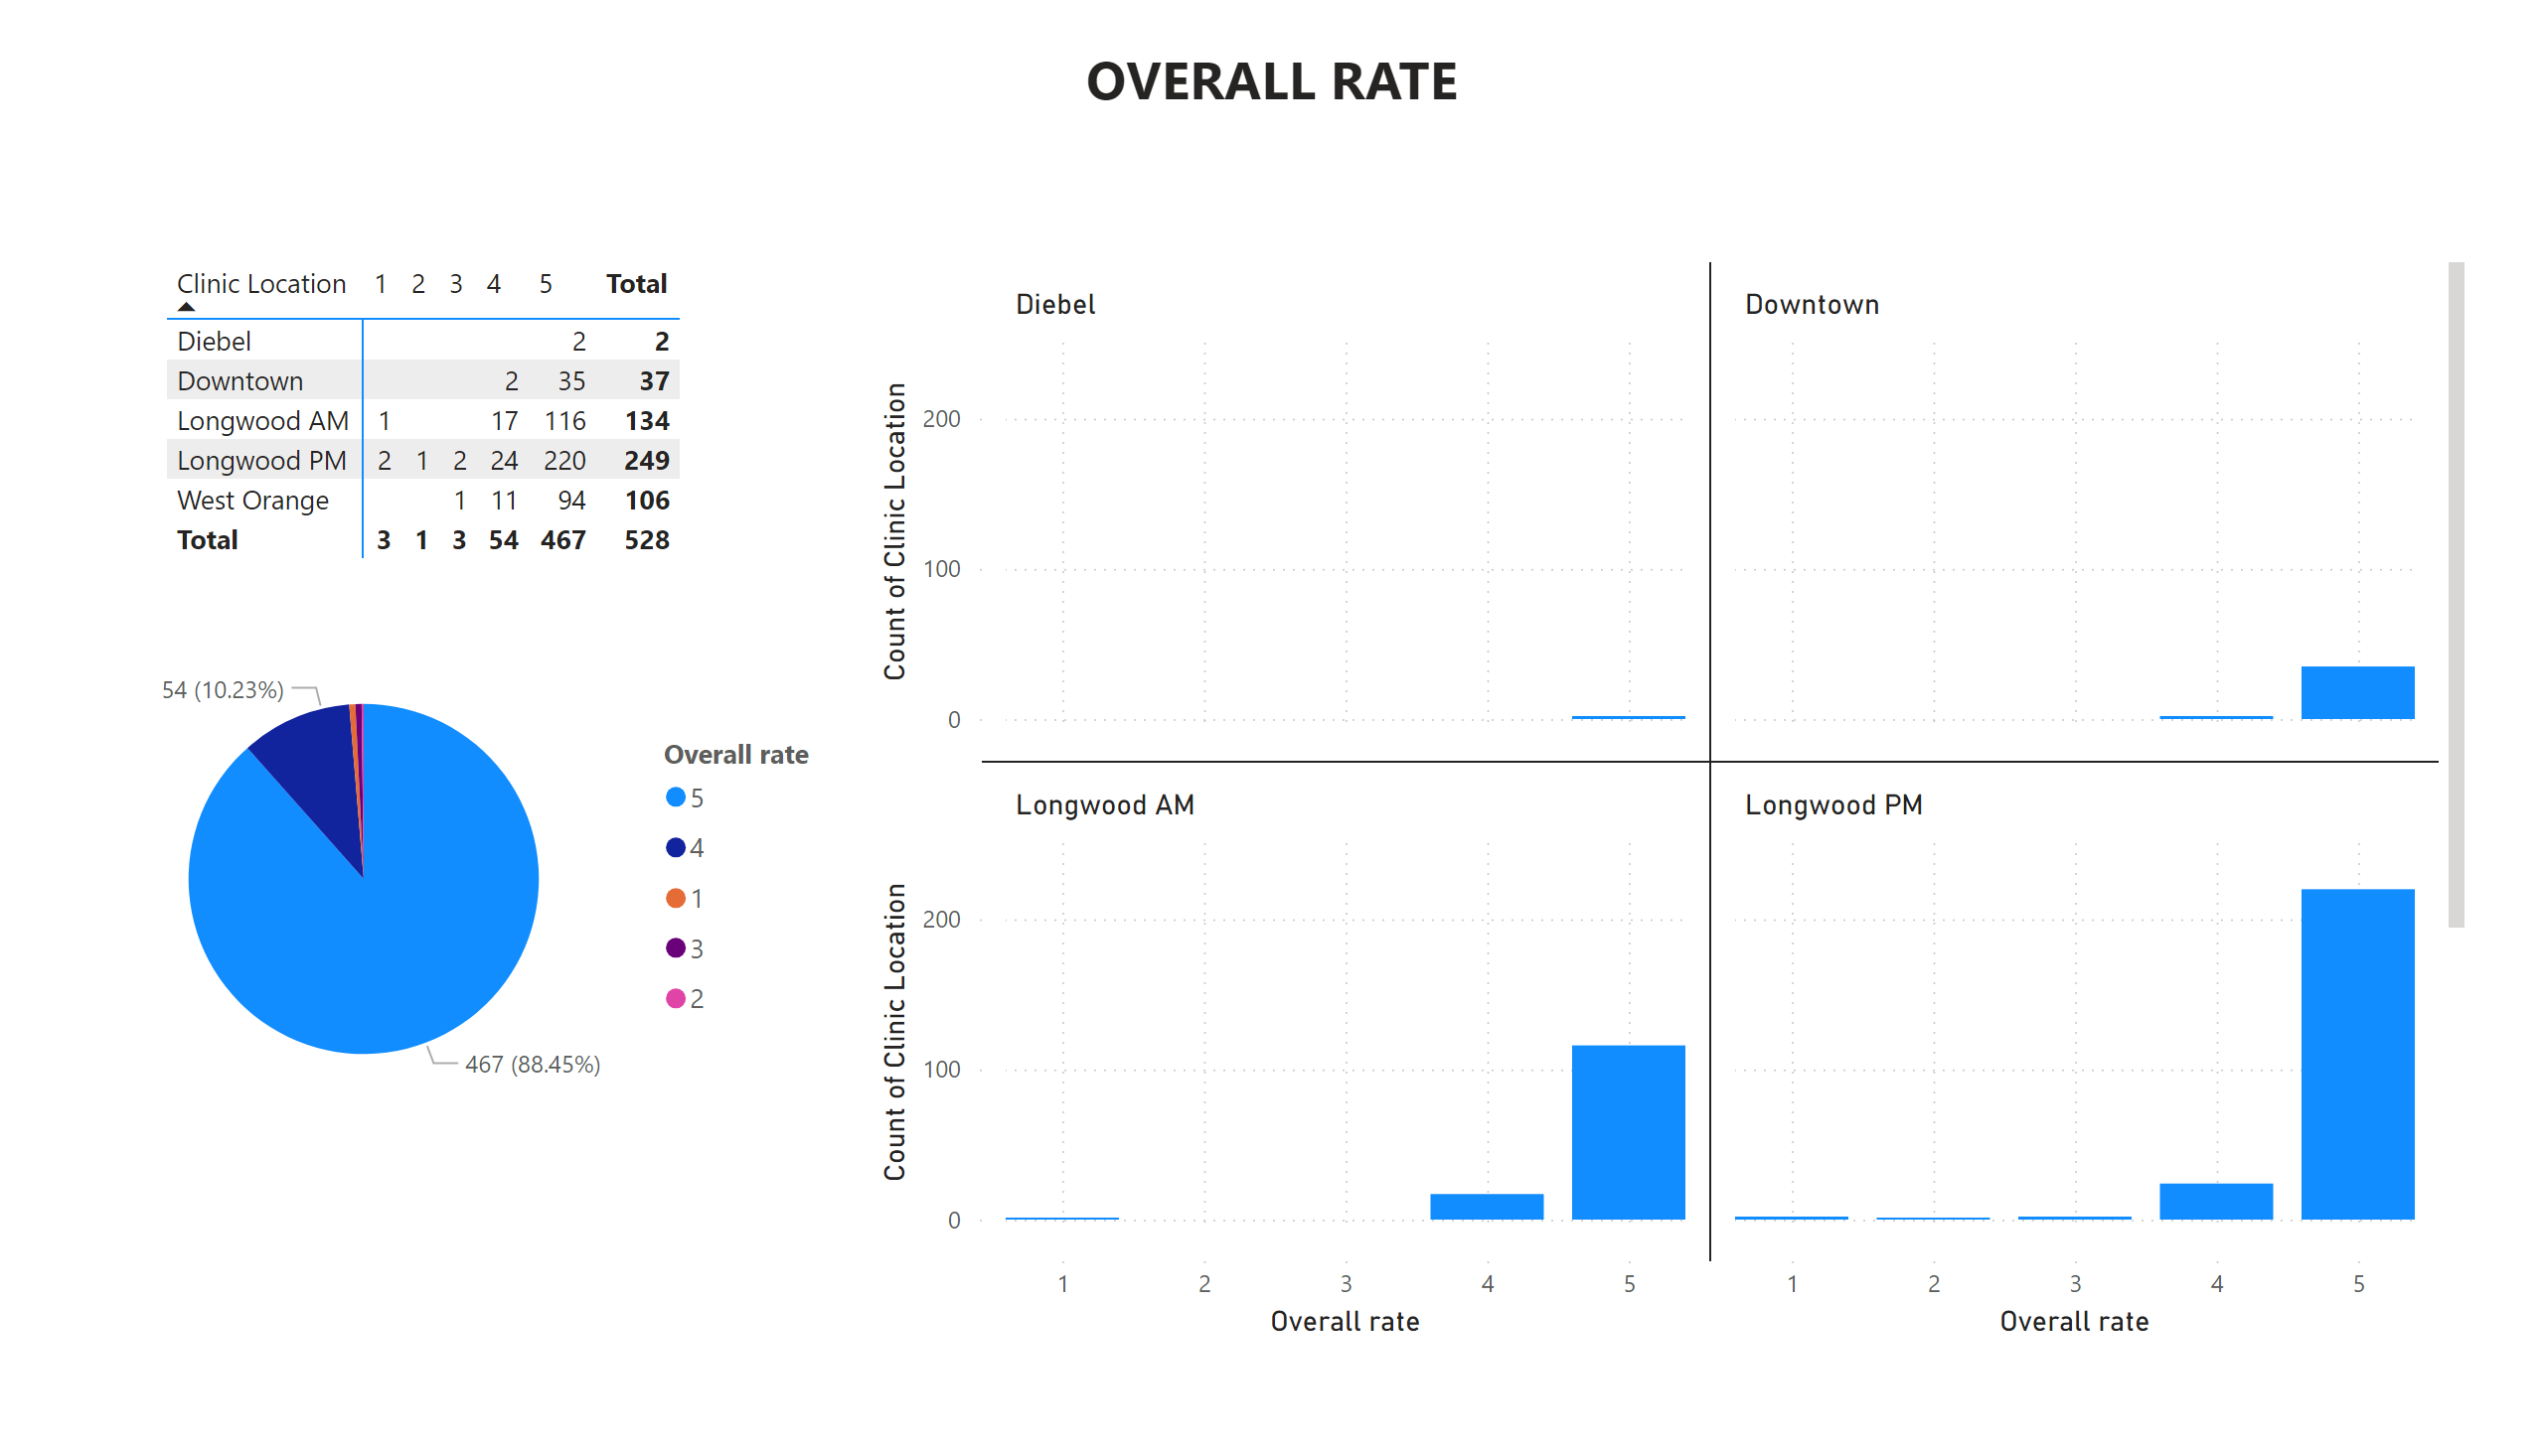
Page 10
Notes:
pieChart
No alt text provided
clusteredColumnChart
No alt text provided
pivotTable
No alt text provided
textbox
No alt text provided

